Slide 1



NATIONAL INSTITUTE OF TECHNOLOGY
JAMSHEDPUR
PRESENTATION FOR CAMPUS CHALLENGE
PROJECT NAME : HEART ATTACK DETECTION SYSTEM
PROFESSOR IN-CHARGE : Dr. JAYENDRA KUMAR
TEAM MEMBERS: Swarnim Kumari (B.Tech ECE 2022)
Devi Manasa Chinni (B.Tech ECE 2023)
Aditya Aryan (B.Tech ECE 2023)
Arsh Mishra (B.Tech MME 2023)
Vivek Tapey (B.Tech PIE 2023)

Slide 2






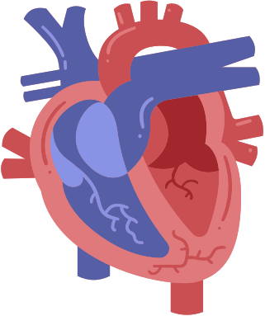
HEART ATTACK DETECTION SYSTEM
Save life , with the early diagnosis of heart attack

Slide 3

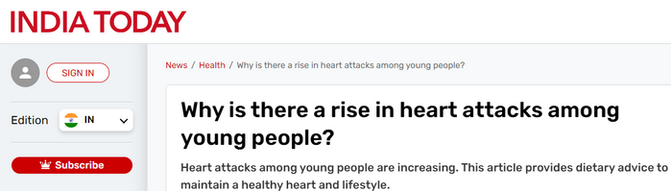
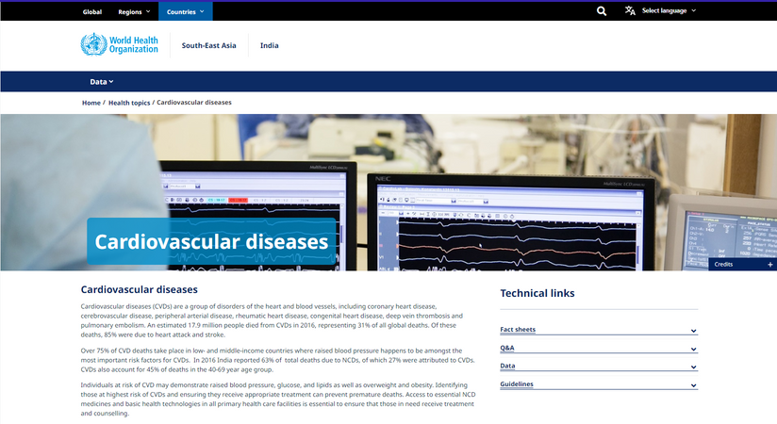
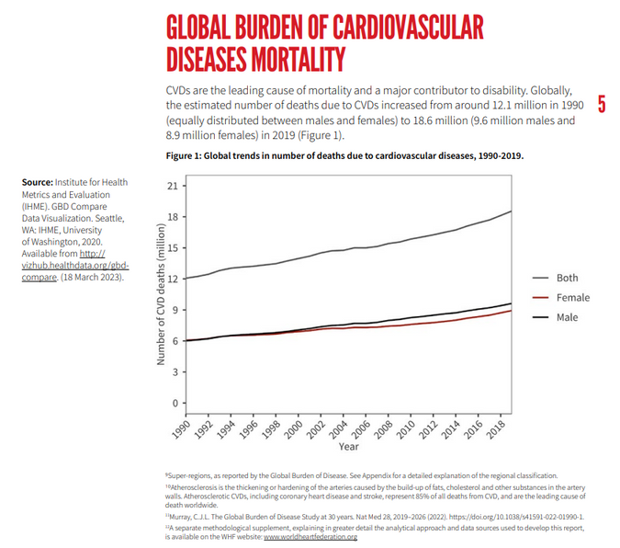
CURRENT PROBLEM
As above India Today stated that Over 32,457 individuals died due to heart attacks in 2022, as per the latest data by the National Crime Records Bureau.
This marks a 10.1% increase from the previous year's figure of 50,739.
As per World Health Organization An estimated 17.9 million people died from CVDs in 2016, representing 31% of all global deaths. Of these deaths, 85% were due to heart attack and stroke.
As per World Heart Federation
The number of deaths due to CVDs in 2019 represented 33% of all global deaths, with ischaemic heart disease (9.1 million deaths) and stroke (6.6 million deaths) totalling 85% of all CVD deaths worldwide.
And reported that – “Global progress against cardiovascular disease (CVD) is flatlining. Though rates of CVD deaths globally have fallen in the last three decades, this trend has begun to stall and, without concerted efforts, is at risk of reversing.”
It was reported that - Up to 80% of premature heart attacks and strokes can be prevented.
But too often the tools that can help diagnose, prevent, and treat CVDs are not benefitting the communities who need them most. Around 4 in every 5 CVD deaths occur in low- and middle-income countries and progress in cardiovascular health is increasingly concentrated in High-Income countries - a glaring health inequity that must urgently be addressed.

Slide 4



OBJECTIVE:
The aim of the project is to provide accurate real-time monitoring of a patient's heartbeat and body temperature, and to promptly alert nearby hospitals in case of any critical abnormalities.

Slide 5




PROJECT OVERVIEW
PROBLEM
SOLUTION
These days many people are losing their lives to heart attacks, which occur when blood flow to the heart is blocked. Late diagnosis often prevents timely intervention, leading to fatalities.
The IoT-based system monitors heart rate to detect heart attacks and alerts using an app and web server.

Slide 6
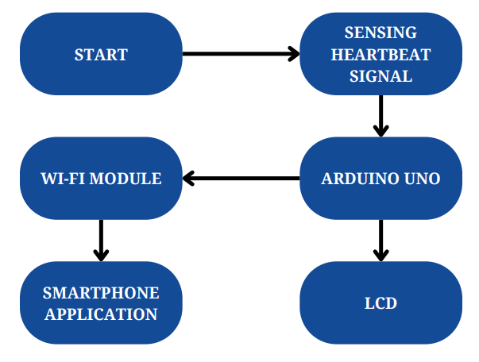

IDEA AND DESCRIPTION
This project involves collecting heartbeat data using a pulse sensor, displaying it on a mobile app, and alerting nearby hospitals using a Bluetooth module. The transmitting circuit includes a heartbeat sensor and an ESP8266 module, which sends data to the app.

Slide 7



METHODOLOGY
MMETHODOLOGY
ETHODOLOGY
METHODOLOGY
Data Collection and Processing:
When the system is turned on (Dedicated button), the Wifi Module (ESP8266-Basic Testing) connects to Wi-Fi and the web server.Then our device begins to collect data. Signals from the sensors are processed by an Microcontroller board (Testing-Arduino) board and then sent to the Wifi-module board which further send the data values to the app and website.
1
METHODOLOGY
Monitoring and Alerts:
Our device would have a lot of pre-set heart rate values for all the normal day to day activities and also dedicated control to put it in sports mode,through our app,which changes our preset values to a little high.
In case of an Medical Emergency i.e values going too low or high,the screen on your interface blinks, and a strong beep sound is produced to alert the subject.
2

Slide 8

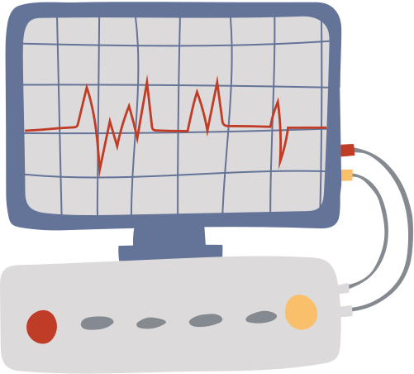

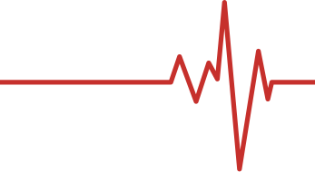
METHODOLOGY
3
Hospital Alert System:
The WIfi (ESP8266)board collects real-time data from the Microcontroller (Arduino) through serial communication and sends it to a cloud server. The cloud server processes the data and in case of the emergency, alerts the nearest hospital if the patient's heartbeat falls outside the safe range.
Data
Collection
Monitoring
Data
Emergency
alert

Slide 9
S.NO. | ITEM
1 | MICROCONTOLLER BOARDS (Arduino Lily,Nano,Portenta H7 etc)
2 | WIFI MODULE(ESP 32 4G LTE)
3 | LCD ADAFRUIT 1..8 INCH (TESTING)
4 | LED+RESISTOR
5 | PULSE SENSOR (x2) / ECG SENSOR
6 | TEMPERATURE SENSOR (x2)
7 | BREADBOARDS OR PCB AND OUTER BODY PARTS
8 | JUMPER WIRES
9 | COIL FOR 3D PRINTER
10 | SOLDERING KIT
11 | BATTERY MODULE
12 | GPS MODULE
13 | MISCELLANEOUS
COMPONENTS
REQUIRED

Slide 10
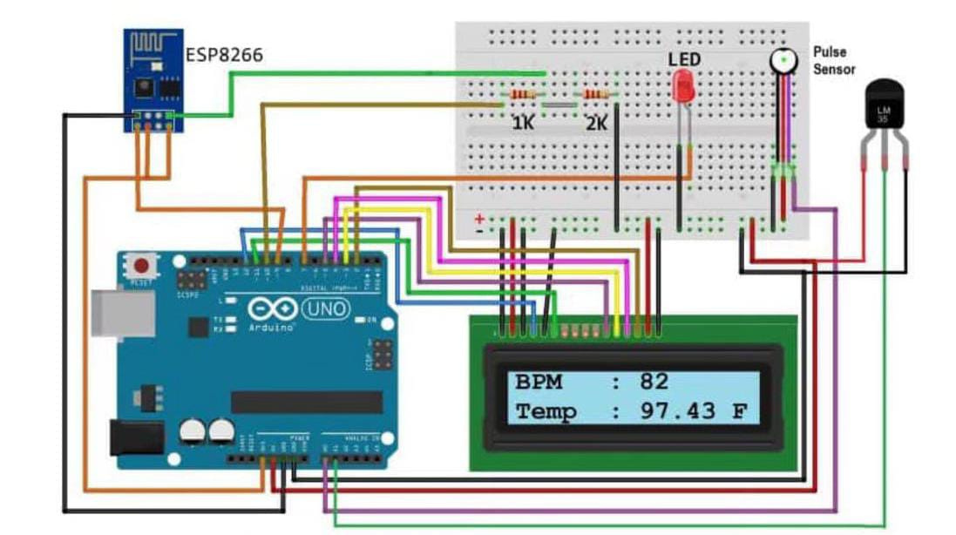
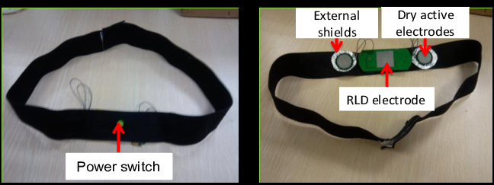
WORKING MODEL

Slide 11
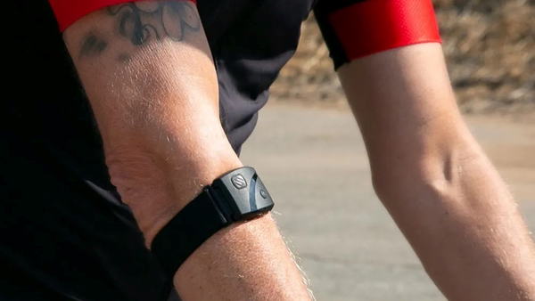
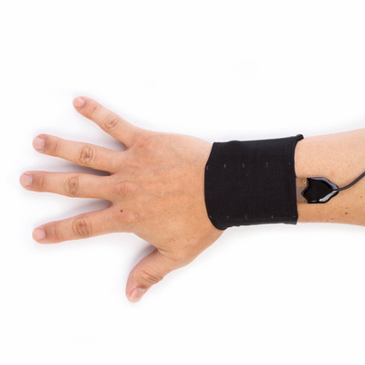
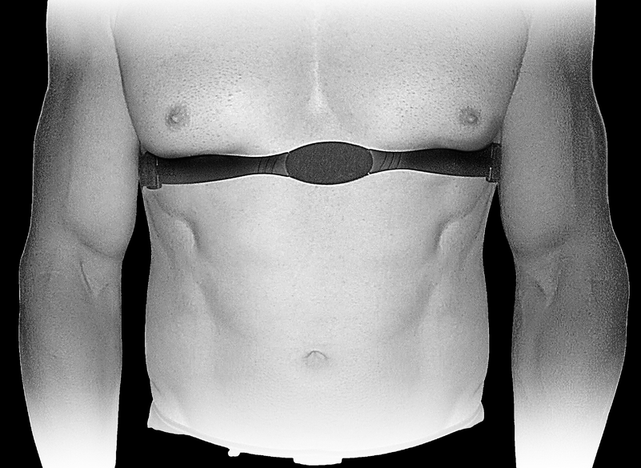
PROTOTYPES
An Exchange of Sensors:
During our research and development ,we will test various ways.
1.Pulse sensors- like the Fermion : MAX 30102 heart rate and oximeter sensor (I2C,UART) which would results in creation of our prototypes like Hand Straps.
2. ECG sensors - Which use electrodes to measure length between each pulse,i.e uses electrical activity of heart.Sensors like ECG AD8232 sensor would results in creation of our prototypes like chest straps.

Slide 12
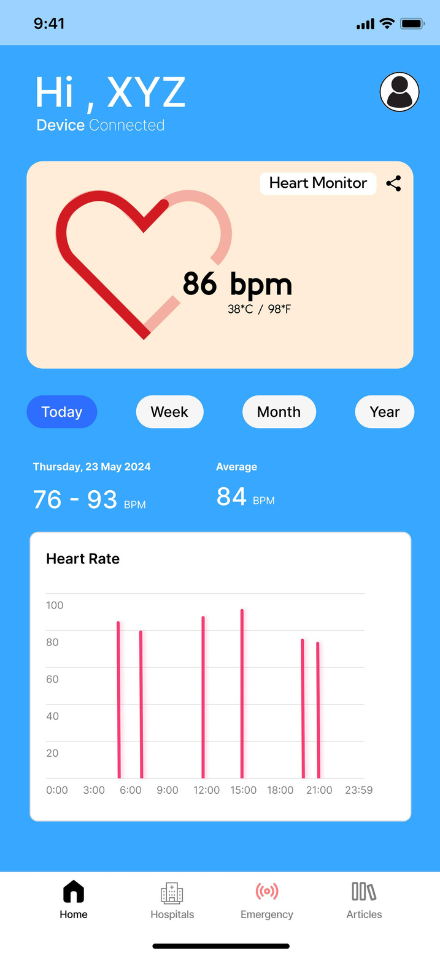

APP
Introducing our innovative health companion app, seamlessly integrating heart rate and temperature monitoring with proactive health alerts. Stay informed about your well-being, explore curated articles and blogs on heart health, and effortlessly locate nearby hospitals for immediate assistance with just a tap.

Slide 13





FEATURES OF THE APP
INTRODUCING OUR CUTTING-EDGE HEALTH APP, DESIGNED TO EMPOWER USERS WITH ESSENTIAL FEATURES:
Health Alerts
EMERGENCY
INSIGHTS
Receive instant notifications regarding your heart health status.
Easily find nearby hospitals and initiate emergency calls with a single click.
Access curated articles and blogs on heart health for informed decision-making.

Slide 14
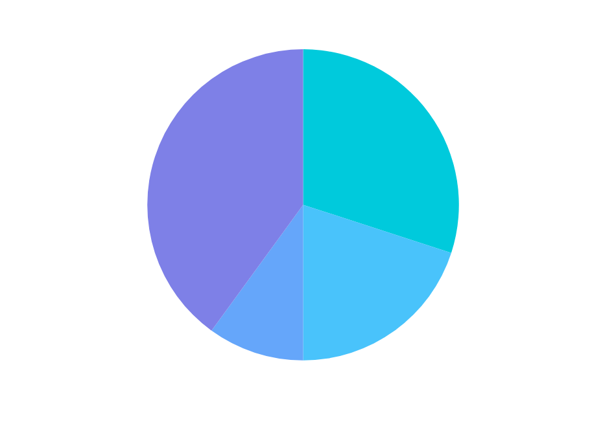
BUDGET
BREAKDOWN
TOTAL AMOUNT = RS. 50000
SL.NO. | AREA | ESTIMATE
1 | RESOURCE & COMPONENTS COSTS | 20000
2 | RESEARCH & DEVELOPMENT | 15000
3 | CONTINGENCY FUND | 10000
4 | TRAVEL & MISCELLANEOUS EXPENSES | 5000

Slide 15


THANK YOU !

